Slide 1

MSU Data Analytics Bootcamp
June 2022 Cohort
Final Project
G7 – “The Blue Power Shells”
FKA “The-Travel-Agents”
Kelly McQuillan
Jon May
Jordan White
Erika Wilson
June 1, 2022
Notes:
Erika

Slide 2
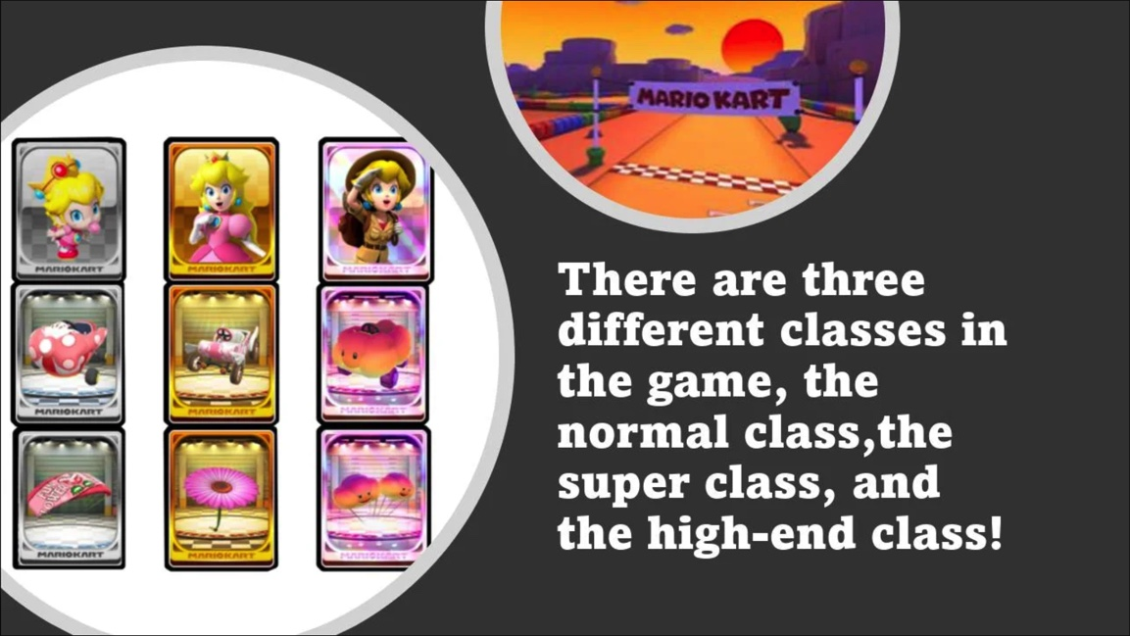
Agenda
Project Intro
Hypothesis
Process
Demo
Gotchas
Notes:
Erika

Slide 3

Notes:
Jon

Slide 4
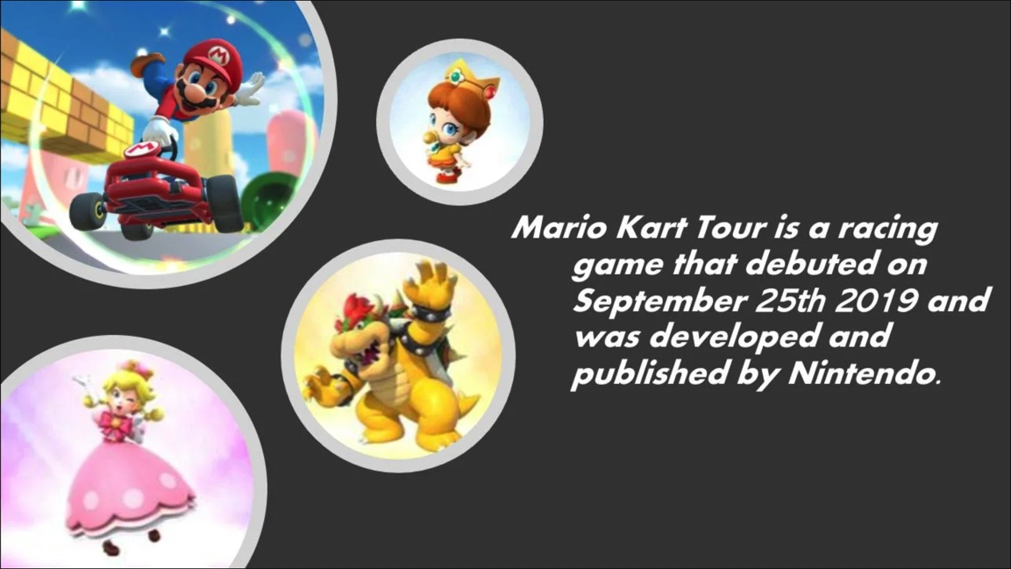
To predict which characteristics would be the best performing on a particular course.
Notes:
Kelly

Slide 5
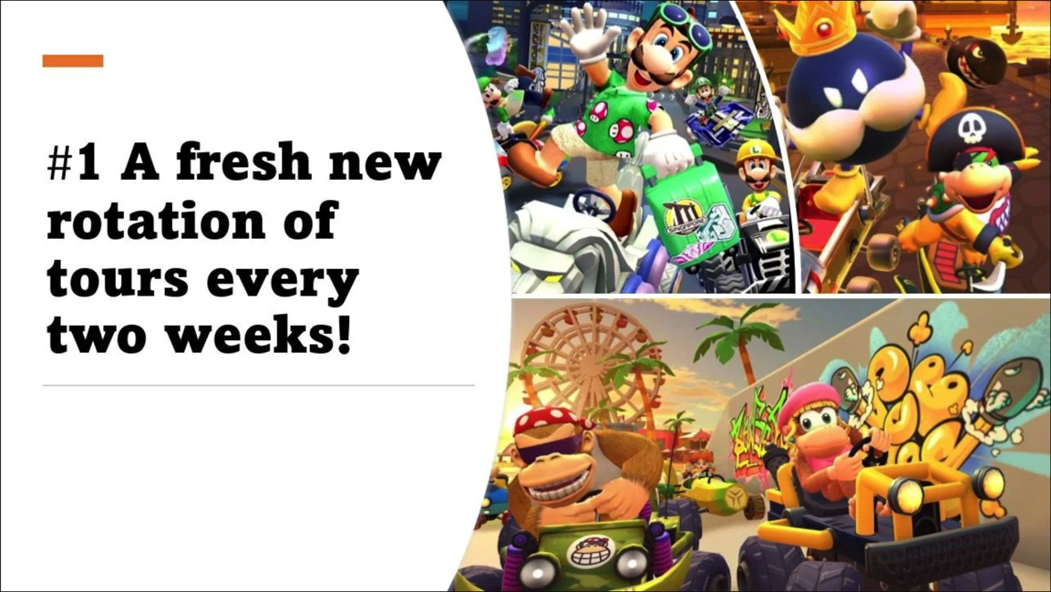
Process
Data Cleaning
2. Database
3. Data Science Model
4. Website
Notes:
Kelly

Slide 6
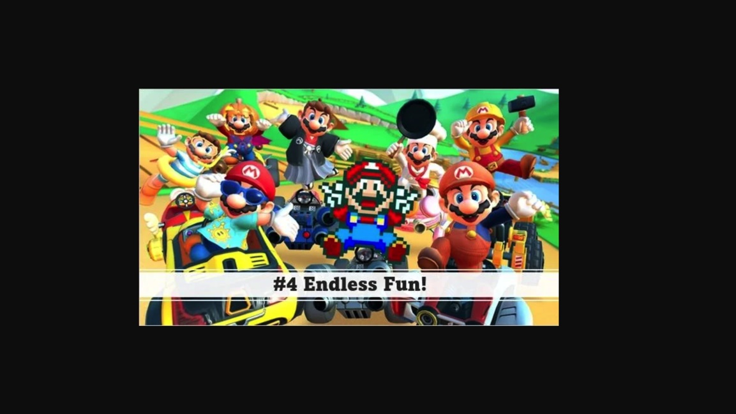
Machine Learning Model

Slide 7
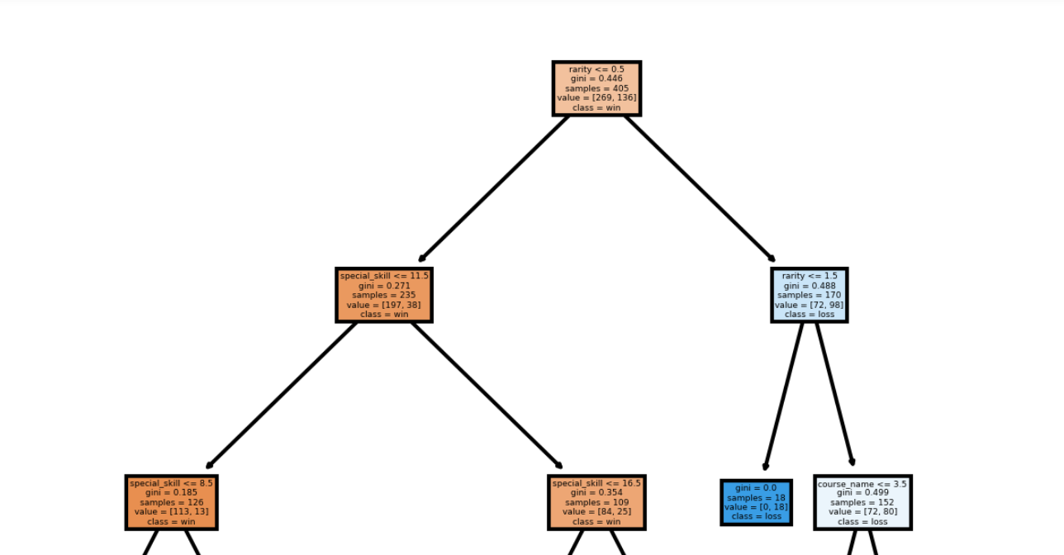
Decision Tree Model
Notes:
Erika

Slide 8

Demo
Notes:
Website

Slide 9
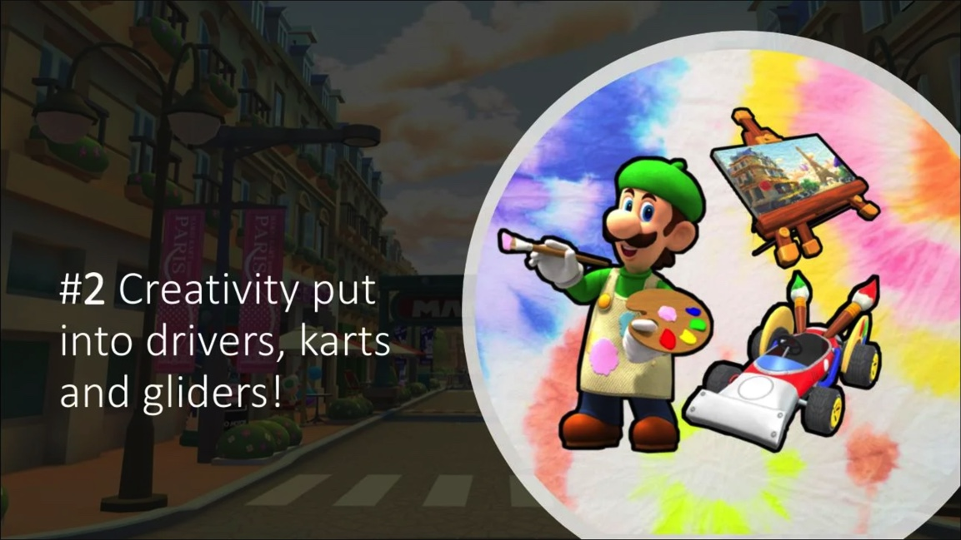
Gotchas
Project changed
Data cleaning
Model selection
Data cleaning
Model selection
DATA CLEANING!!!!
Notes:
All

Slide 10
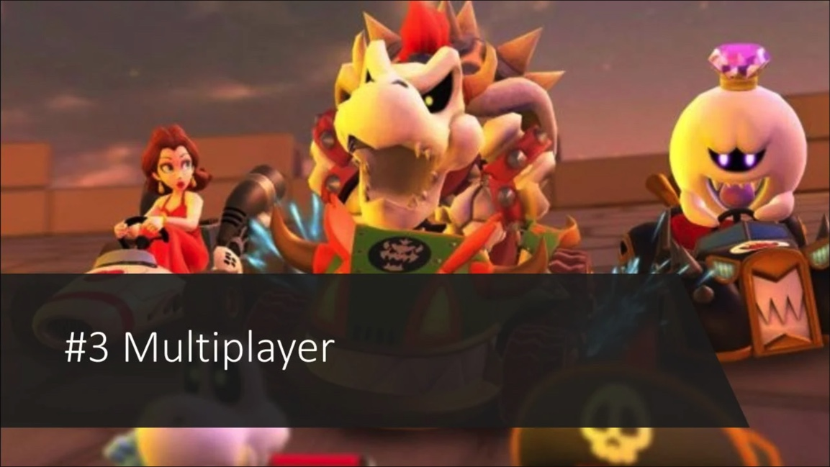
Thank you!!!

Slide 11
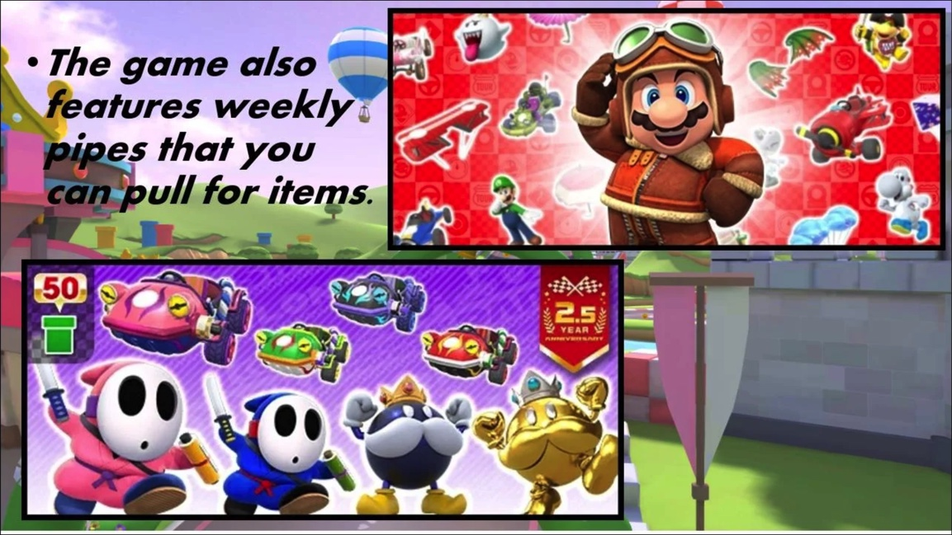
Data Source:
https://mario-kart-tour-api.herokuapp.com/
GitHub:
https://github.com/JordanWhite21/TheBluePowerShells

